Slide 1
Panoptic Segmentation
Li Yin

Slide 2
Outline
Introduction
Challenges
Paper 1: Instance Segmentation by Deep Coloring
Paper 2: UPSNet: A Unified Panoptic Segmentation Network
Ideal Properties
References
Notes:
Semantic Segmentation and Instance Segmentation plays a high important role in scene understanding. Currently, they are separate as two different tasks, however, panoptic segmentation unifies them to a single task. This task can have potential benefits: faster speed, non-overlapping property, better evaluation metrics.
The purpose of this talk is to introduce the task Panoptic Segmentation, the first paper that trained it end-to-end PSNet. In addition, we discussed the problem of two-stages instance segmentation such as Mask-RCNN, and introduced one paper which trained instance segmentation without either region-proposal network or object detection, which is Instance Segmentation by Deep Coloring.

Slide 3
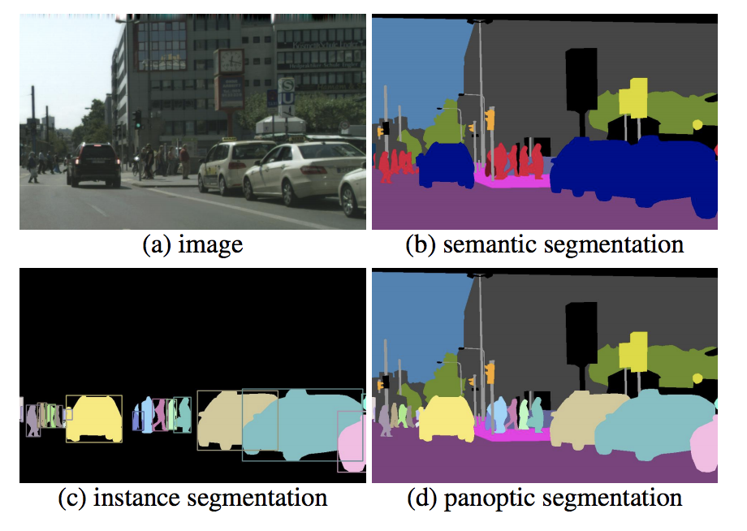
Introduction
Semantic Segmentation
Best Accuracy and speed among all
Instance Segmentation
Current mainstream is two-stages solution such as Mask-RCNN, which is composed of object detection and semantic segmentation inside of object bounding box
Panoptic Segmentation
A unified solution for semantic segmentation and instance segmentation
Metrics: https://www.jeremyjordan.me/evaluating-image-segmentation-models/

Slide 4
Problems of Two-stages Instance Segmentation
Due to the object detection:
Region proposal-based object detection is slower compared with one-shot detector such as SSD.
Can not handle occlusion between objects well
Due to semantic segmentation inside of each object
Hard to distinguish adjacent objects of same class
Overlapping: one pixel can be potentially labeled as multiple instances if their bounding boxes overlaps

Slide 5
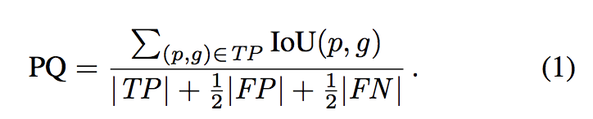
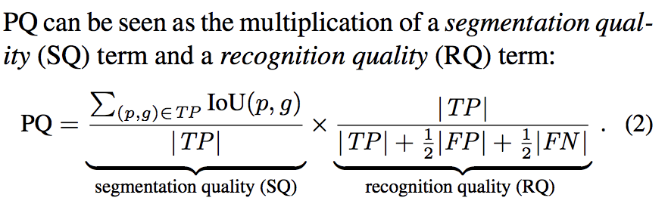
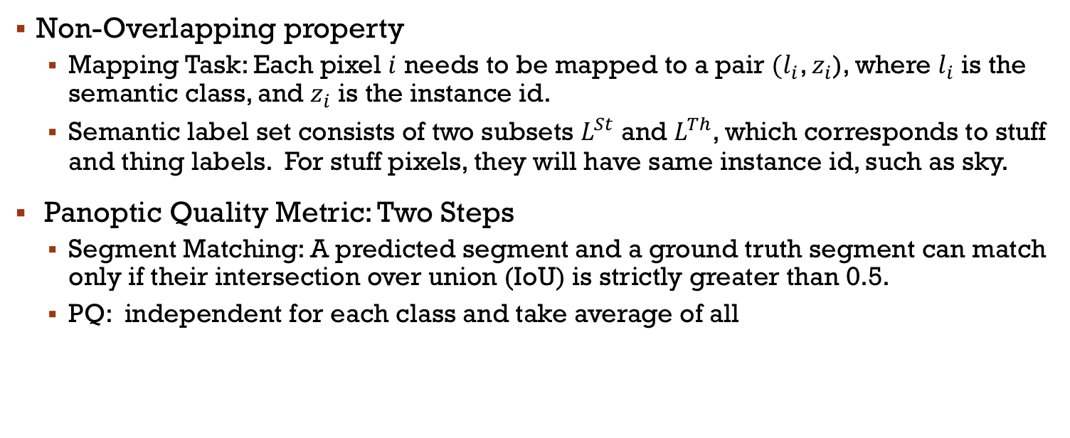
Panoptic Segmentation
Non-Overlapping property
Mapping Task: Each pixel $i$ needs to be mapped to a pair $(l_{i}$, $z_{i}$), where $l_{i}$ is the semantic class, and $z_{i}$ is the instance id.
Semantic label set consists of two subsets $L^{St}$ and $L^{Th}$, which corresponds to stuff and thing labels. For stuff pixels, they will have same instance id, such as sky.
Panoptic Quality Metric: Two Steps
Segment Matching: A predicted segment and a ground truth segment can match only if their intersection over union (IoU) is strictly greater than 0.5.
PQ: independent for each class and take average of all
Notes:
Segmentation quality is the average IoU of matched segments. . Therefore, all segments receive equal importance regardless of their area.
Segmentation quality is simply the average IoU of matched segments.

Slide 6
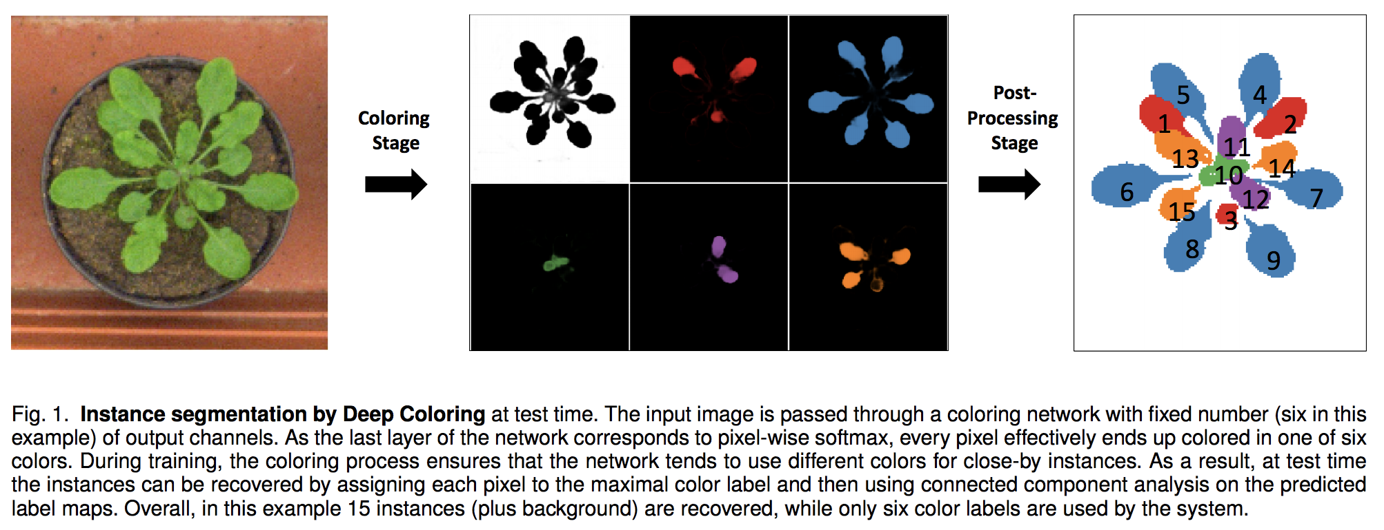
Deep Coloring
Trained as a semantic segmentation
Num_classes: background + number of colors

Slide 7

Deep Coloring - Inference
Inference is the same as semantic segmentation, multiple channels choosing the one with the maximum probability after softmax . We get a map $Z$ of size h*w, z[p] in {1, …, C}.
Post-processing on map $Z$: Find all connected components in the map, and treat the non-background connected component and larger than a threshold as object instances.
Notes:
In the implementation, it uses find_countours which is implemented with marching square algorithms.

Slide 8
Deep Coloring - Learning
Goals of learning is to ensure that for any training image each object instance is:
colored using the same color (all pixels will have high values in a certain output map y[c], c> 1
Pixels adjacent to this instance have low value at the same channel.
Coloring during Loss : Learning uses softmax pixel-wise cross entropy loss same as of semantic segmentation. The only difference is the need to choose a color channel for each ground truth object instance

Slide 9

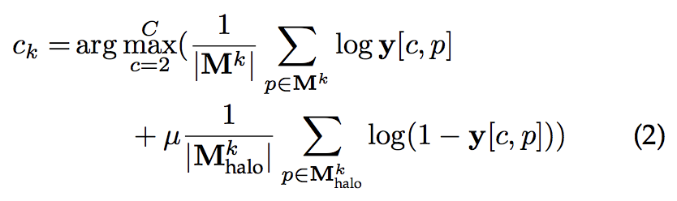
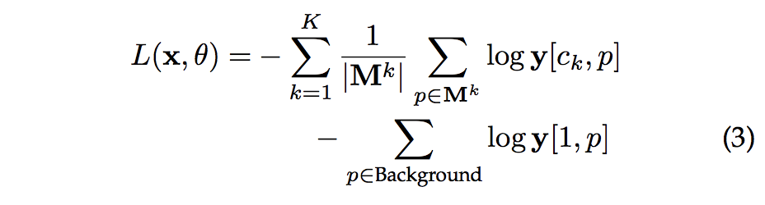
Deep Coloring - Learning
Coloring during Loss Computation
M1_halo
M1
(2) Dynamically pick a color channel, and generate a ground truth on the fly. K*H*W into a C*H*W. If we look at each instance as a connected component, then this is to color a graph with C channels of color.
Note: it doesn’t really implicitly convert the ground truth. It only take the best
Notes:
X: training image, K objects,

Slide 10
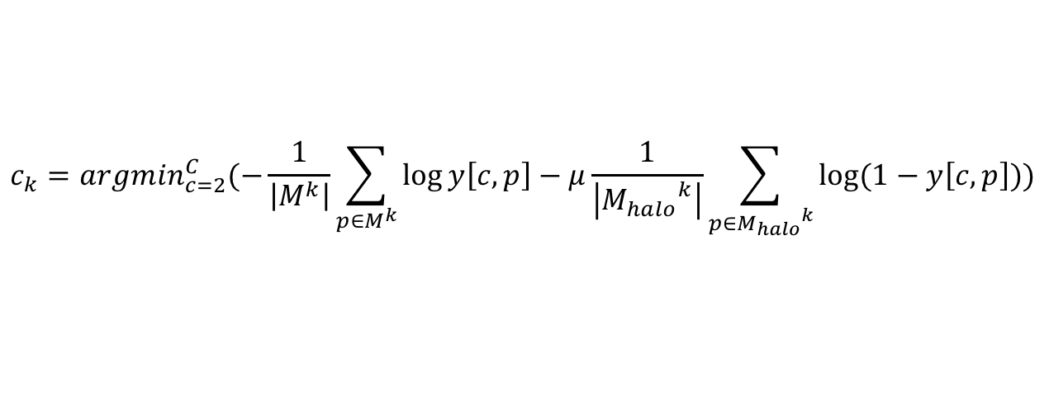
Deep Coloring – Learning
The only difference compared with Semantic Segmentation
1
3
2
Image: I
Color channels
$$c_{k}=arg\min_{c=2}^{C}(−\frac{1}{\left|M^{k}\right|}\sum_{p∈M^{k}}{\log{y\left[c, p\right]}}−μ\frac{1}{\left|{M_{halo}}^{k}\right|}\sum_{p∈{M_{halo}}^{k}}{\log{(1−y\left[c, p\right]}}))$$
Notes:
Try putting each instance on each color channel, and which one has the smallest loss

Slide 11
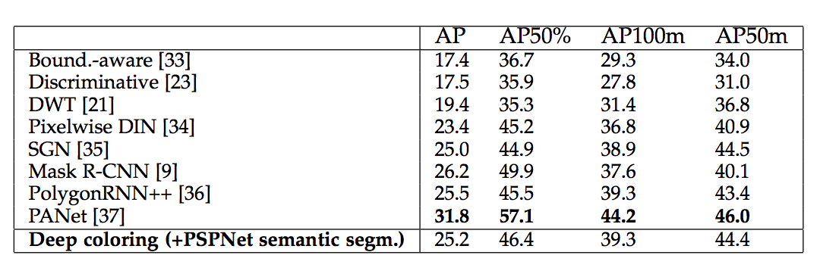
Deep Coloring - Learning
Accuracy:

Slide 12
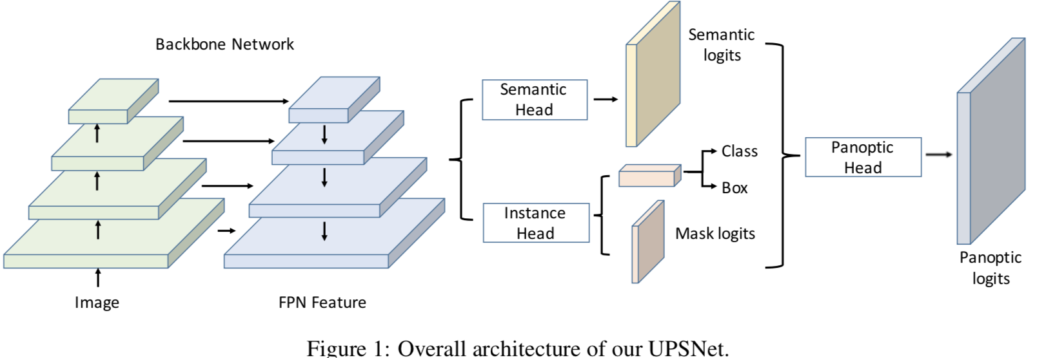
UPSNet: A Unified Panoptic Segmentation Network
1. Instance Head is the same as of Mask-RCNN

Slide 13
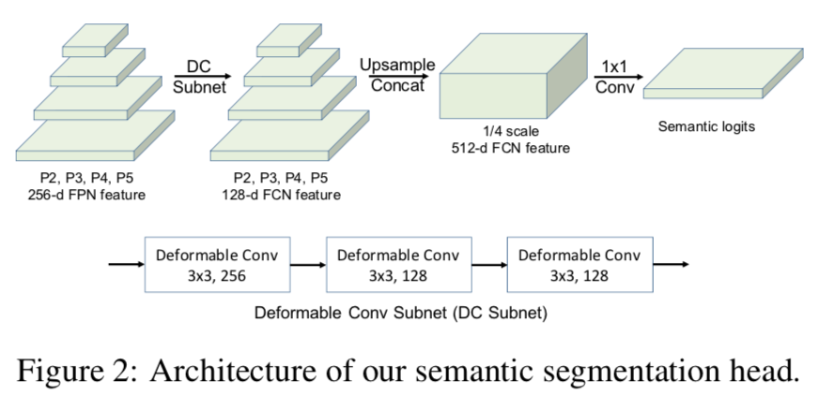
UPSNet
Semantic Segmentation has a ROI loss:

Slide 14
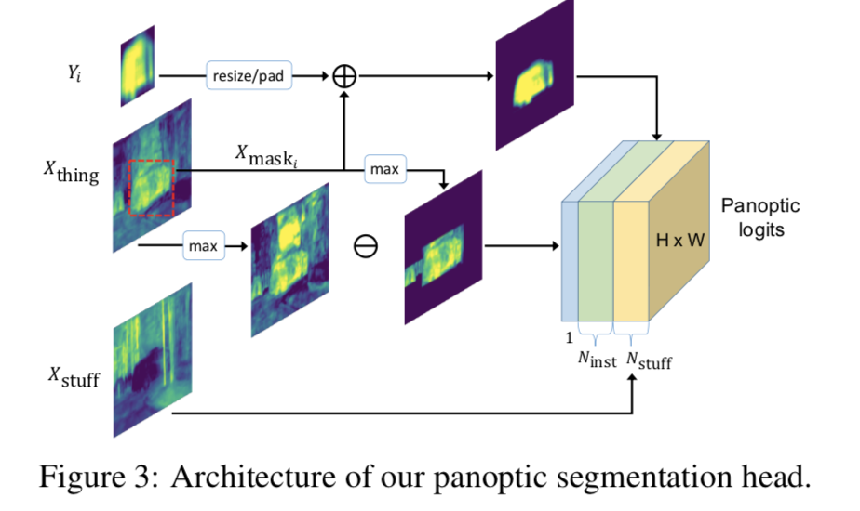
UPSNet: Panoptic Head
For any image, the number of instances is determined by ground truth instances during training. During inference, we rely on a mask pruning process NMS.
The goal of our panoptic segmentation head is to first produce a logit tensor Z which is of size (Nstuff+Ninst)×H×W and the uniquely determine both the class and instance ID for each pixel.
The panoptic segmentation head is then associated with the standard pixel-wise cross entropy loss
Notes:
Yi is from mask rcnn, X thing is from the area of the semantic map.

Slide 15
UPSNet: Panoptic Head
During inference, once we predict the instance ID following the above procedure, we still need to determine the class ID of each instance.
We can either use the prediction of semantic segmentation or the mask-rcnn. Mostly when face inconsistency, the semantic segmentation is trusted because semantic head typically achieves better accuracy.
Notes:
Yi is from mask rcnn, X thing is from the area of the semantic map.

Slide 16
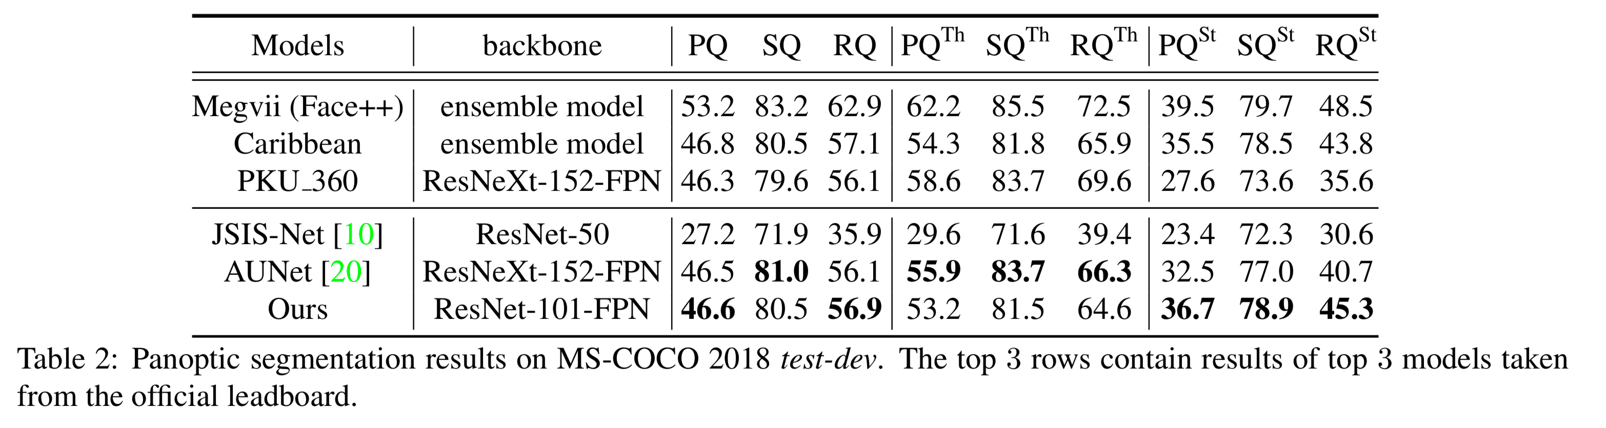
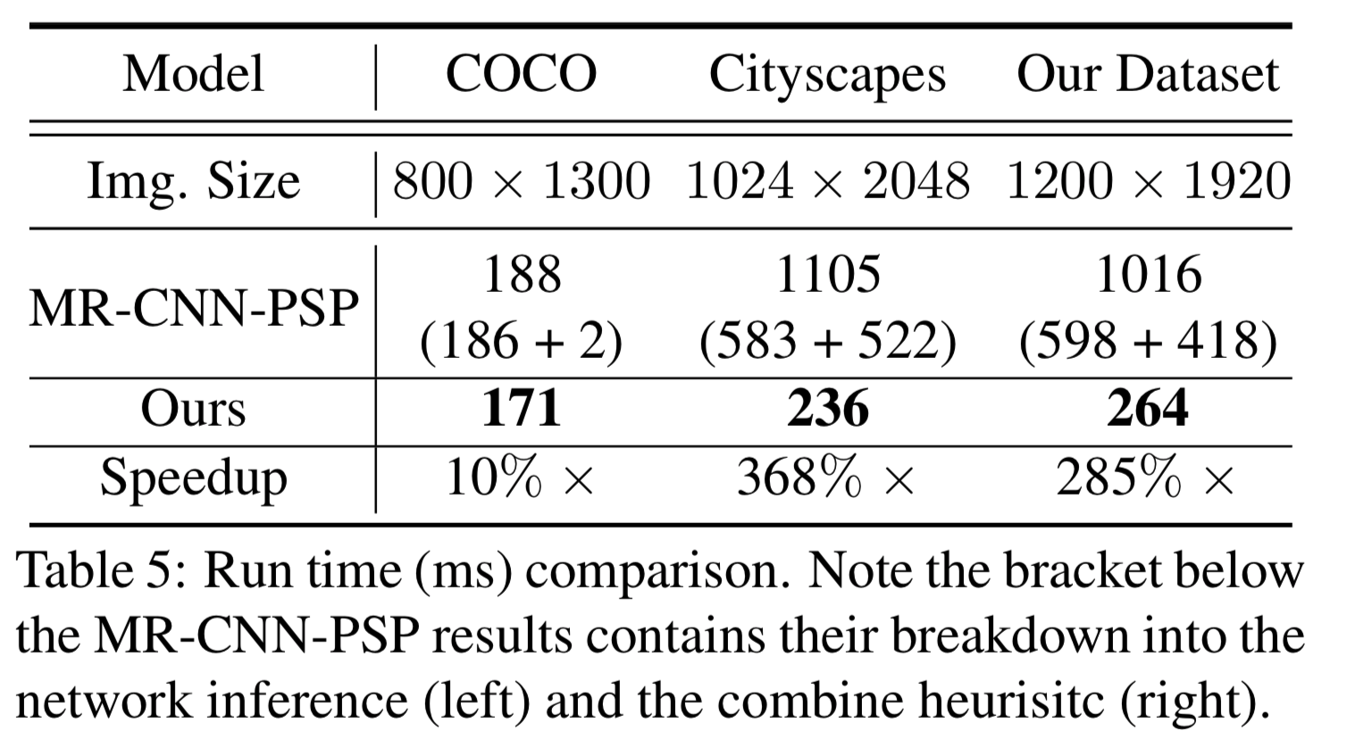
UPSNet: Performance
Accuracy:

Slide 17
Ideal properties
Proposal-free Instance Segmentation
Instance Segmentation and Semantic Segmentation will share feature extractor
End-to-End Trainable
Fast Inference

Slide 18
References
Xiong, Y., Liao, R., Zhao, H., Hu, R., Bai, M., Yumer, E.,&Urtasun, R. (2019). UPSNet: A Unified Panoptic Segmentation Network. arXiv preprint arXiv:1901.03784.
Kirillov, Alexander, et al. "Panoptic segmentation." arXiv preprint arXiv:1801.00868 (2018).
Kulikov, Victor, Victor Yurchenko and Victor S. Lempitsky. “Instance Segmentation by Deep Coloring.” CoRR abs/1807.10007 (2018): n. pag.

